Slide 1
Wentworth Interactive Map
Tyler Anderson
Matt Collins
Aladdin Guseynov
Wentworth Institute of Technology
Professor Thai
June 7, 2019
Web Development COMP 4650-02

Slide 2
Use Case Definition – Wentworth Campus Map
User can select a building and classroom from a dropdown list or search for based on attributes such as room number, name, or function (e.g. cafeteria, gym, library, etc.)
The selected area (either building or room) will become highlighted on map to show exact location.
User can also open a tab to display an isolated view of the building they selected, with just the floor plan of that building visible.
User can clear search query with a button press to reset the map, or just exit the program.
The user will be able to interact with a map legend containing icons of notable sites on campus (parking lots, dining services, study rooms, etc.).
Clicking on these icons will filter the map to display these points of interest.
Links will be provided to direct user to pages were they will find more information on the school, directions, parking, etc.

Slide 3
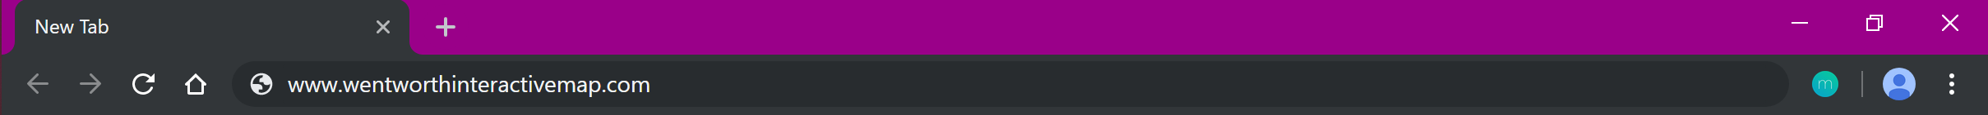



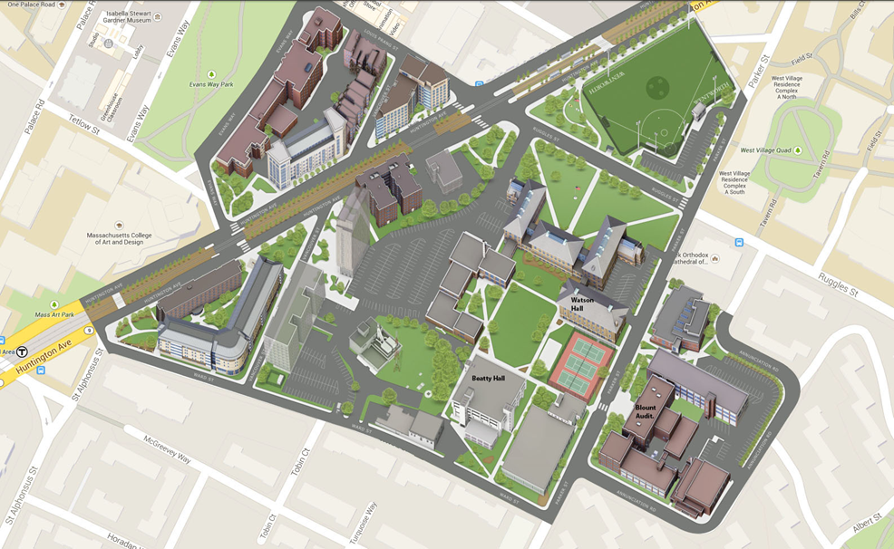
[Navigation Bar with On-Brand Color Scheme]
[Map Navigation Tabs]
[Search Bar]
[Interactive Campus Map]
LEGEND
Icon
Icon
Icon
Icon
…
^[Map legend with clickable icons to display notable points on map]
^[Filter displayed map area by building name or resource (library, gym, etc.)]
[Building]
[Building]
[Building]
[Building]
[Resources Pane]
About | Directions | Parking | Contact

Slide 4
Class Diagram
LEGEND
Icon
Icon name
searchMap()
displayIcon()
reset()
MAP
image
highlightedArea
dragMap()
openHighlight()
displayFloorplan()
back()
reset()
1
1
BUILDING
name
notableSiteTags
resources
queryRoom()
getFloorplan()
∞
1
SEARCHBOX
searchBar
buildingList
queryMap()
openPage()
reset()
1
1
1
1
∞
1
ROOM
number
resources
highlightedArea
FLOORPLAN
name
image
resources

Slide 5
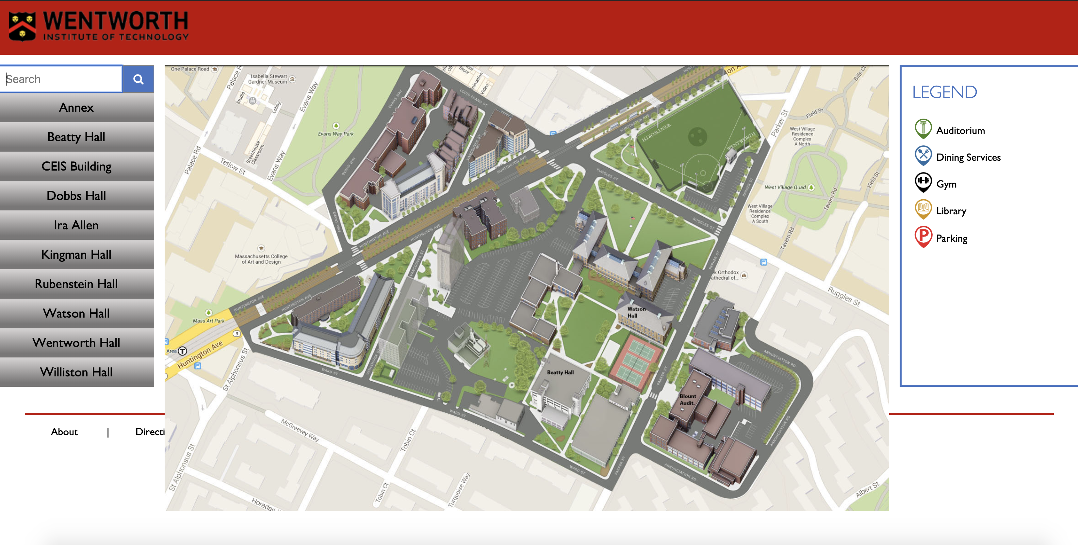
Homepage

Slide 6
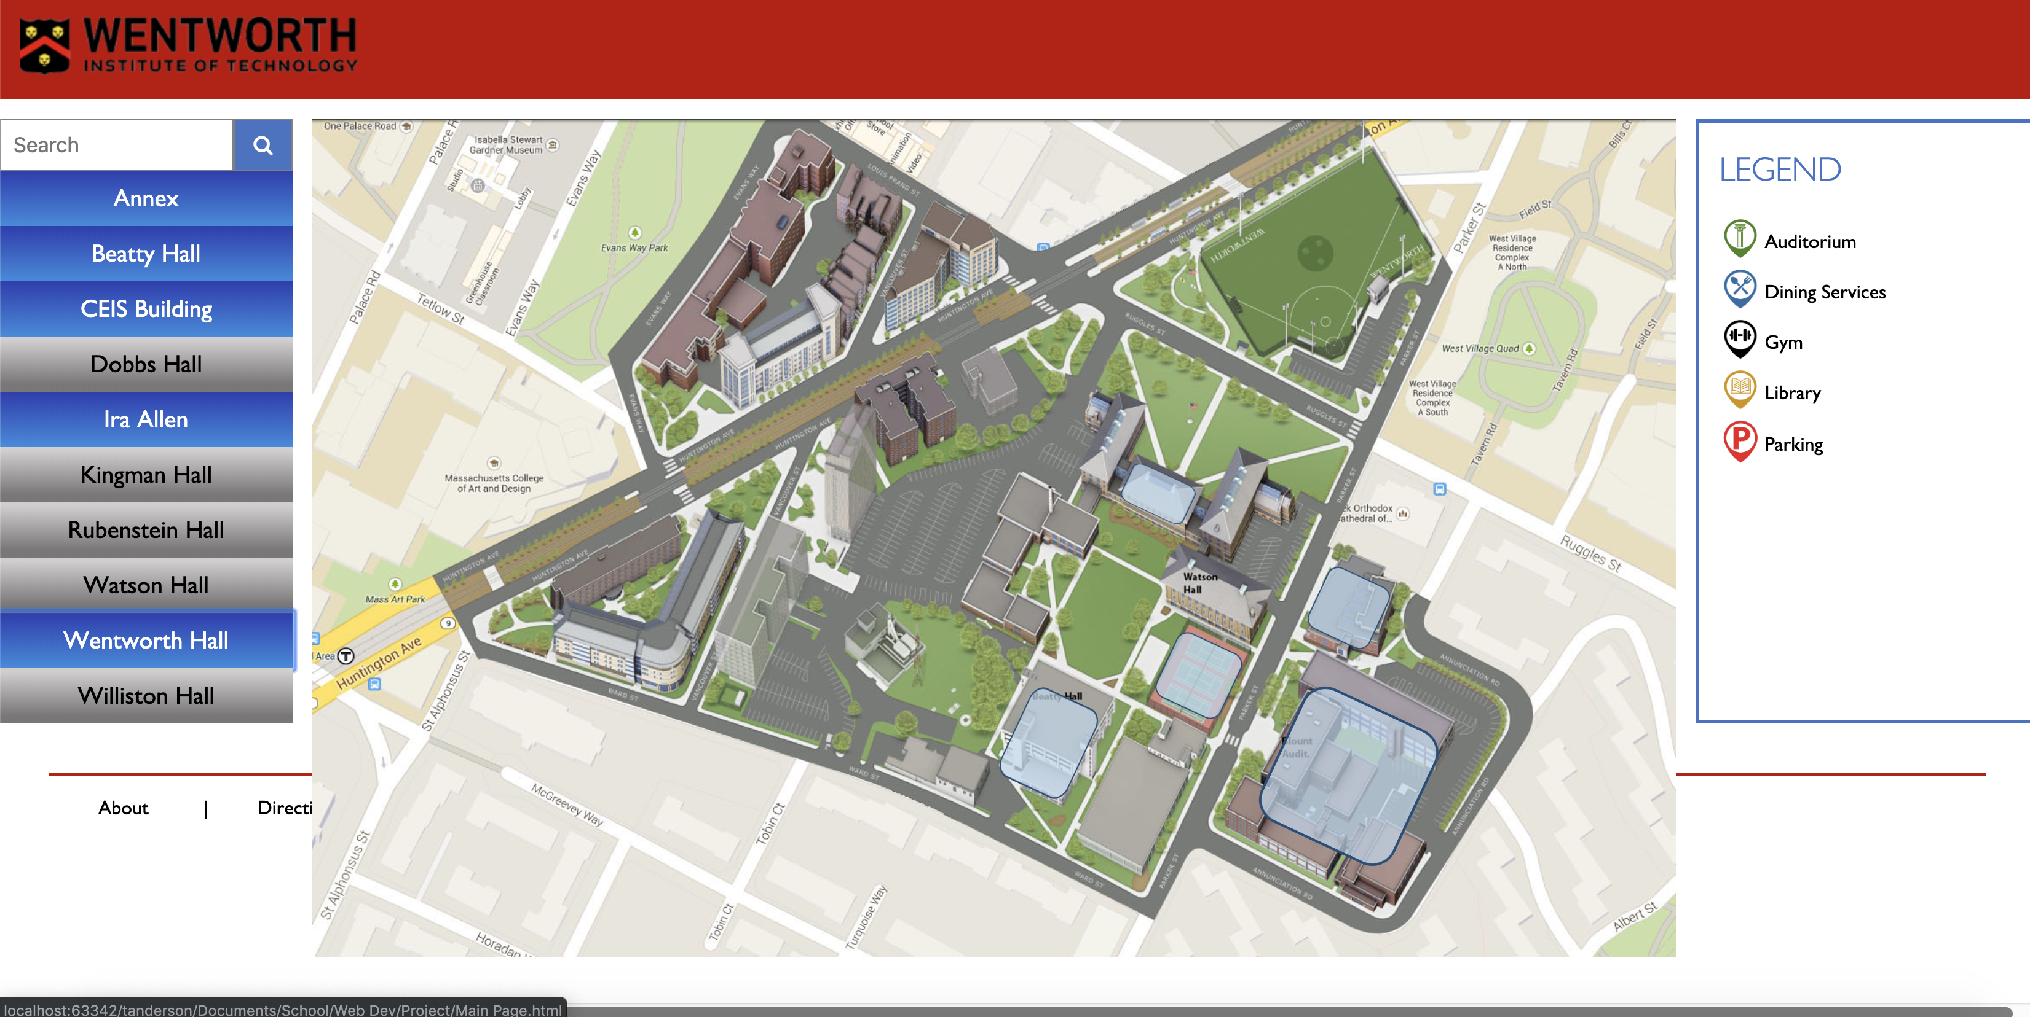
Building Finder

Slide 7
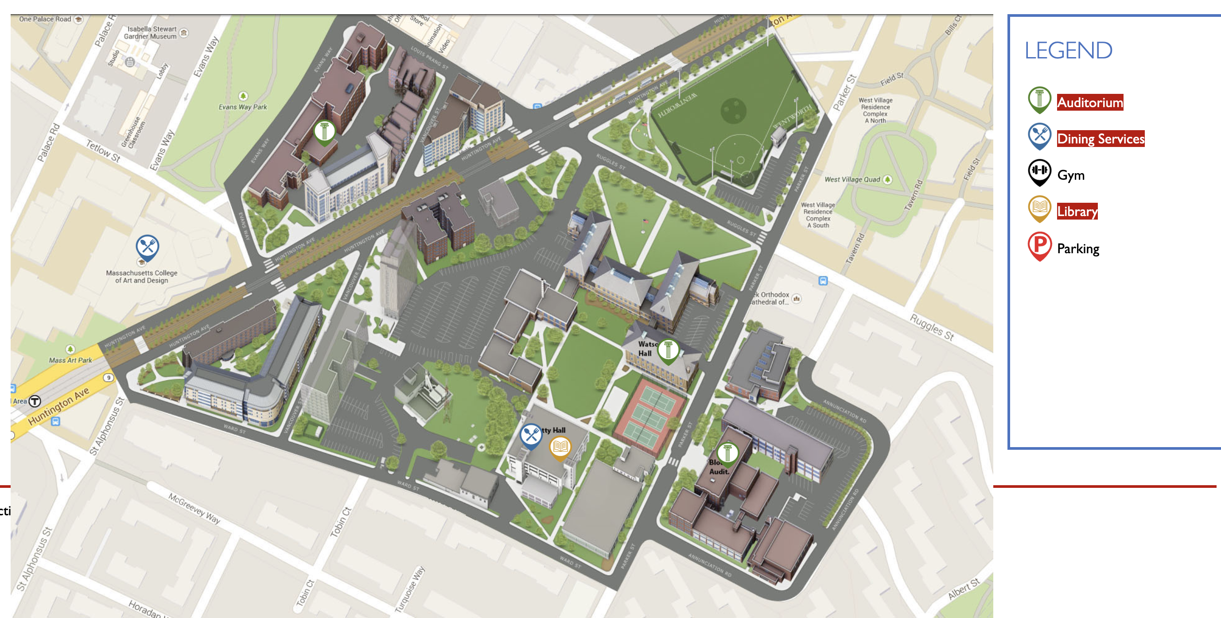
Facilities Locator

